Slide 1

2023 An Agile Case Study
SNHU Travel Website: How Agile Saved the Day

Slide 2
SNHU Travel
Vision
Mission
Risks
Help maintain SNHU Travel’s position as one of the top travel agencies in New Hampshire by providing a site for customers looking to book great deals on travel.
Creating a site that engages visitors looking for deals on travel, and providing content to inform them of travel options, and to encourage them to make travel bookings through the site.
Risk losing market share if customers cannot book travel with SNHU Travel online.
Notes:
Give a mile-high overview of the project that the Scrum team was assigned.

Slide 3
Use cases
Top 5 Travel Destinations
Filterable by Budget
Filterable by Preferences
User Story
As an end user, I want to click a link to view the top five destinations list, so that I can see the most popular locations for travel to educate myself on the best places to go.
User Story
As an end user, I want to Click on a link to view the top five destinations list within my budget so that I can see the popular locations for travel within my budget to educate myself on the best places to go.
User Story
As an end user, I want to Click on a link to view the top five destinations list based on my preferred packages based on profile preferences so that I can See the popular locations for travel based on my preferences to educate myself on the best places to go.
Notes:
Review the fundamental use cases presented

Slide 4
The Scrum Framework
The Agile Manifesto
We are uncovering better ways of developing software by doing it and helping others do it. Through this work, we have come to value:
Individuals and interactions over processes and tools
Working software over comprehensive documentation
Customer collaboration over contract negotiation
Responding to change over following a plan
That is, while there is value in the items on the right, we value the items on the left more.
© 2001-2022 Agile Manifesto Authors
An alternative to the Waterfall Method currently utilized by Chada Tech
Notes:
(‌Beck, K. et al., 2001)

Slide 5
Scrum Roles
Product Owner
Development Team
Scrum Master
Responsible for maximizing the product's business value. It's a one-person role that communicates the customer perspective of the product to a Scrum Team. The Product Owner is empowered to make decisions related to the product. The Product Owner is also responsible for the Product backlog, ensuring that it is sprint-ready and prioritize to maximize value with the ultimate goal of customer delight.
A self-organizing professionals who are empowered and accountable as a group to deliver a potentially releasable Increment of "Done" product during each Sprint. The resulting synergy of the Development Team optimizes their overall efficiency and effectiveness.
Responsible for making sure Scrum is understood and properly used. The Scrum Master is a servant-leader for the Scrum Team, facilitating and mentoring to create a cohesive, high functioning team. The Scrum Master is also responsible for removing impediments to the development process to make all interactions maximize the value created by the Scrum Team.
Notes:
Discuss each role within the Scrum Framework (Overeem, 2016).

Slide 6
Meet the Team
Client
Amanda
Chadra Tech Management Team
Executive Sponsor
Executive Sponsor
Jane
Product Owner
Christy
Developers
Scrum Master
Ron
Software Developer
Nicky
Software Tester
Brian
Notes:
All key stakeholders are included as part of the Scrum team in this diagram to emphasize that everyone must embrace the Agile mindset for the Scrum team to be successful (Cobb 2015).

Slide 7
Definitions
Product Backlog: contains all of the use cases identified for a given development project prioritized by business value. Use cases are broken down into individual items that will be further refined until they are Sprint-ready.
Backlog Item: A required system feature. For a system task it may have the format “The system must <perform some task> to <achieve some goal>.” User centered items are referred to as User Stories.
User Story: A user centered backlog item in the format “As a user, I want to <perform some task> so that I can <achieve some goal>.”
Sprint: a time-boxed event in which a Scrum team focuses only on single product increment. For this project
Sprint-ready: refers to a backlog item or user story that is sufficiently granular to be completed in one Sprint.
Sprint Backlog: refers to backlog items that have been moved from the Product Backlog for the current Sprint.
Task: Sprint Backlog items are broken down into discrete tasks

Slide 8
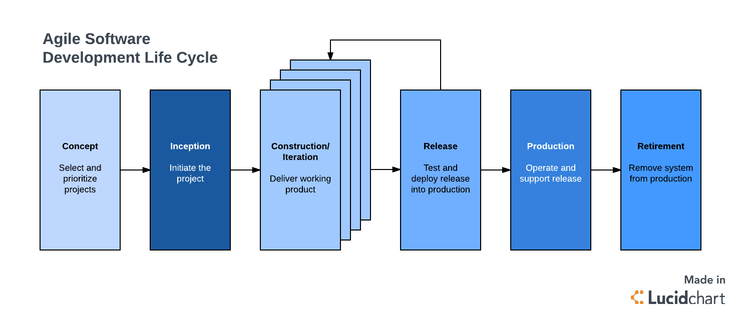
https://www.lucidchart.com/blog/agile-software-development-life-cycle
Notes:
Discuss the phases of development including planning, analysis, design, implementation, maintenance, and retirement as it is used in the Agile methodology.(The Stages of the Agile Software Development Life Cycle, 2017)

Slide 9
Scrum Ceremonies
Sprint Planning
Daily Scrum
Sprint Review
Sprint Retrospective
During this ceremony, the Development Team selects the items from the Product Backlog that they believe can be accomplished in the upcoming Sprint. They must start with the highest priority items.
During this ceremony, also known as the Daily Standup, each team member gives a brief status update summarizing what they accomplished the previous day, what they plan to accomplish today, and discuss any impediments that they are encountering.
During this ceremony the team meets with stakeholders to review the results of the Sprint. The team describes any challenges they encountered and demonstrate the features implemented in releasable iteration. The stakeholders give their final approvals and provide feedback.
After the Sprint Review the team meets for the Sprint Retrospective. During this ceremony the team discusses what went well, and what didn’t and how to utilize these insights in future Sprints.
Story Time
Sprint Retrospective
Although not currently an official Scrum ceremony, many Scrum teams have embraced this meeting to have a structured discussion to refine the Product Backlog to prepare it for the next Sprint Planning ceremony. Story Time generally is held in the middle of the current Sprint.
Notes:
Scrum projects begin like any other. After discovering the purpose and objectives of the project a planning phase is initiated. In Scrum, this phase is limited to outlining high-level scope and understanding, generally speaking, the deliverable that is expected. The balance of Scrum process is iterative, with each Sprint producing a production-ready product with the highest value features implemented first. There are several Scrum ceremonies that are utilized to optimize the results of each Sprint: Sprint Planning, Daily Scrum, Story Time, Sprint Review, and Sprint Retrospective (Valacich, J. S., & George, J. F., 2019).

Slide 10
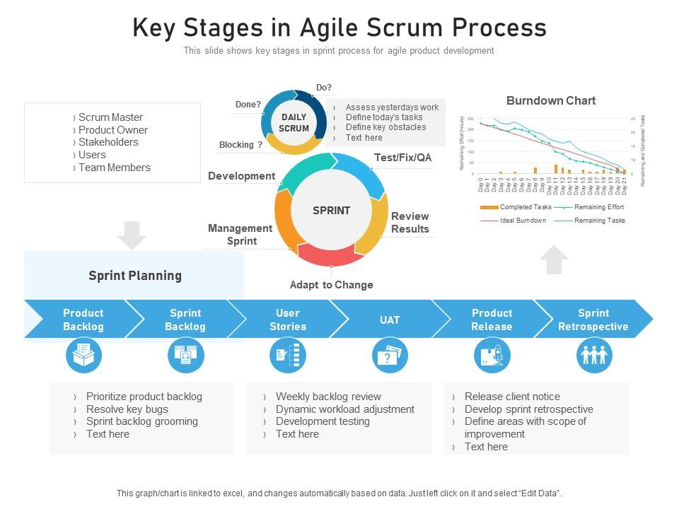
https://www.slideteam.net/key-stages-in-agile-scrum-process.html
Notes:
Slideteam.net provides a very useful diagram to understand this process better (Key Stages in Agile Scrum Process, 2021)

Slide 11
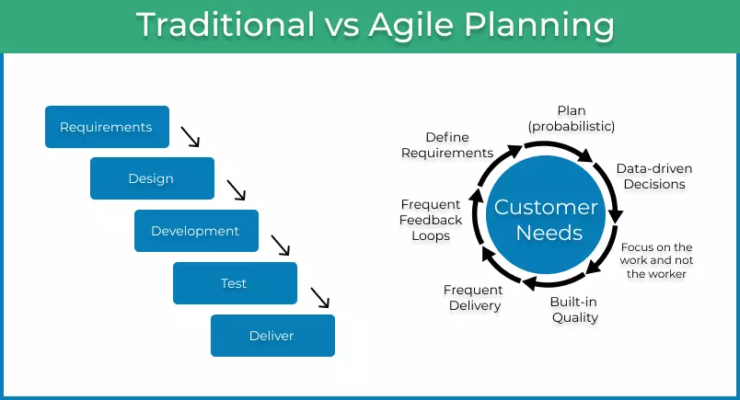
https://kanbanize.com/agile/project-management/planning
Notes:
In the traditional waterfall method currently used by Chasa Tech, each phase of the development lifecycle finishes before the next phase starts. Several problems can occur because of its lack of flexibility. In many software projects many of the features may not be well defined at the beginning which not only delays the project, but also may result in poorly designed use cases, causing design defects that won’t be detected until the product is delivered. In addition, no testing occurs until the development phase is complete, making detection of errors more difficult, and fixing them more challenging. (The Complete Beginners Guide to Agile Project Planning, 2023)

Slide 12
Recommendation
The Scrum framework provides flexibility and efficiency in the Software Development Life Cycle of a software product as demonstrated in the SNHU Travel Website project. This was highlighted when the client made changes during the final days of the implementation phase, with the Agile team successfully pivoting. Chada Tech will benefit by transitioning most projects to an Scrum based model, although exceptions should be made based on the needs of individual projects.
‌
‌

Slide 13
References
‌Beck, K. et al. (2001) The Agile Manifesto. Agile Alliance. http://agilemanifesto.org/
Charles G. Cobb. (2015). The Project Manager’s Guide to Mastering Agile : Principles and Practices for an Adaptive
Approach. Wiley.
Key stages in agile scrum process. (2021, August). Slideteam.net.
https://www.slideteam.net/key-stages-in-agile-scrum-process.html
Overeem, B. (2016, April 15). Characteristics of a Great Scrum Team. InfoQ.
https://www.infoq.com/articles/great-scrum-team/
‌The Complete Beginners Guide to Agile Project Planning. (2023). Kanban Software for Agile Project Management.
https://kanbanize.com/agile/project-management/planning
The Stages of the Agile Software Development Life Cycle. (2017, December). @LucidSoftware.
https://www.lucidchart.com/blog/agile-software-development-life-cycle
Valacich, J. S., & George, J. F. (2019). Modern Systems Analysis and Design (9th ed.). Pearson Education (US).
https://mbsdirect.vitalsource.com/books/9780135172827
‌
‌

Slide 14
Question and Answers
‌
‌
Notes:
Take questions from audience. Respond, and offer follow up for any questions that arise that may need research

